Slide 1


PANNÓNIA PROGRAMME

Slide 2
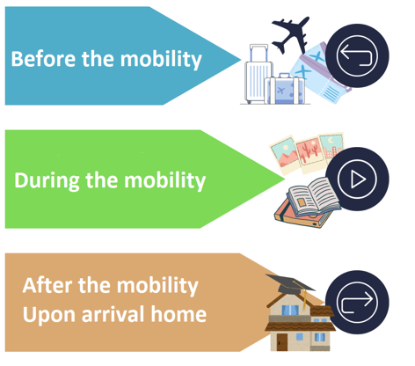
Table of Contents
Website: https://ipc.sze.hu/en_GB/home
Rules and regulations
Scholarship
To do’s

Slide 3
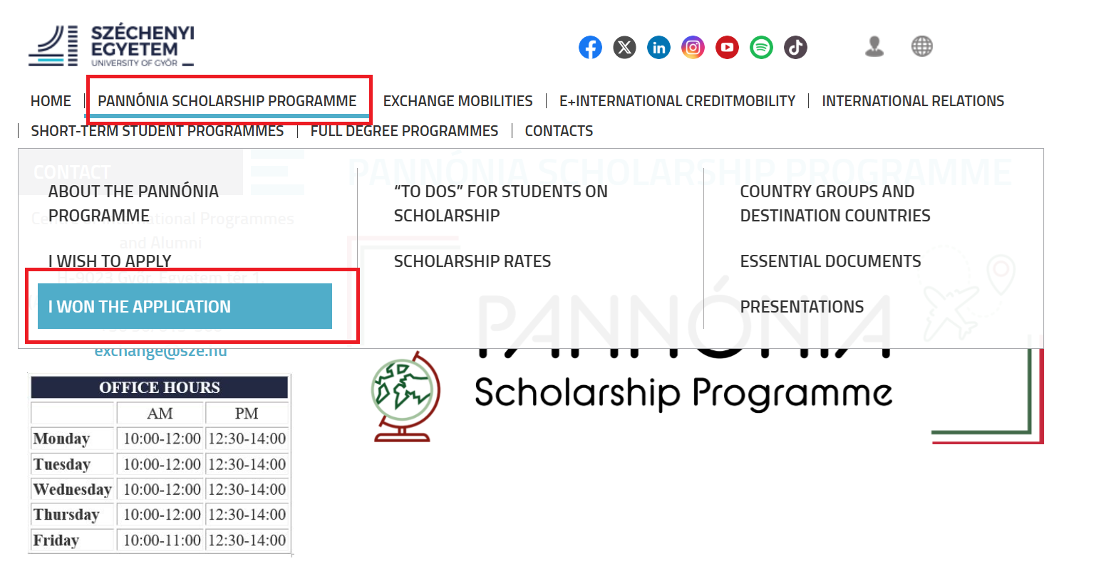

Website
https://ipc.sze.hu/en_GB/home → Pannónia Scholarship Programme →I won the application

Slide 4

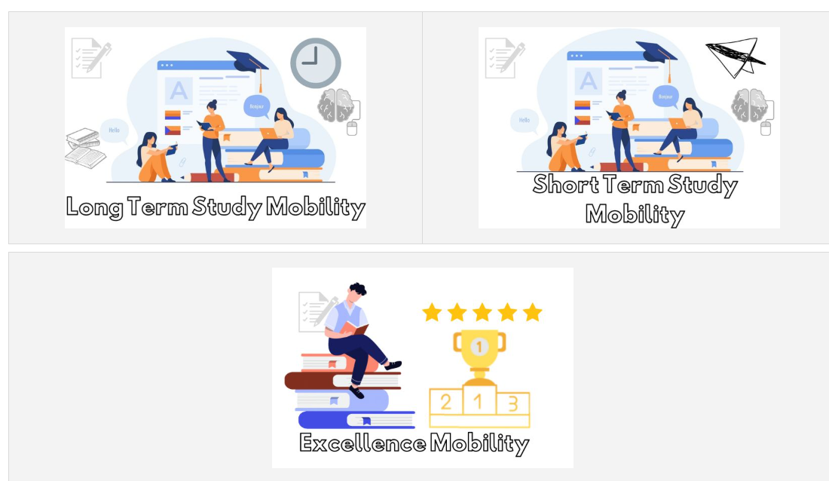
Website
https://ipc.sze.hu/en_GB/home → Pannónia Scholarship Programme →I won the application
→

Slide 5
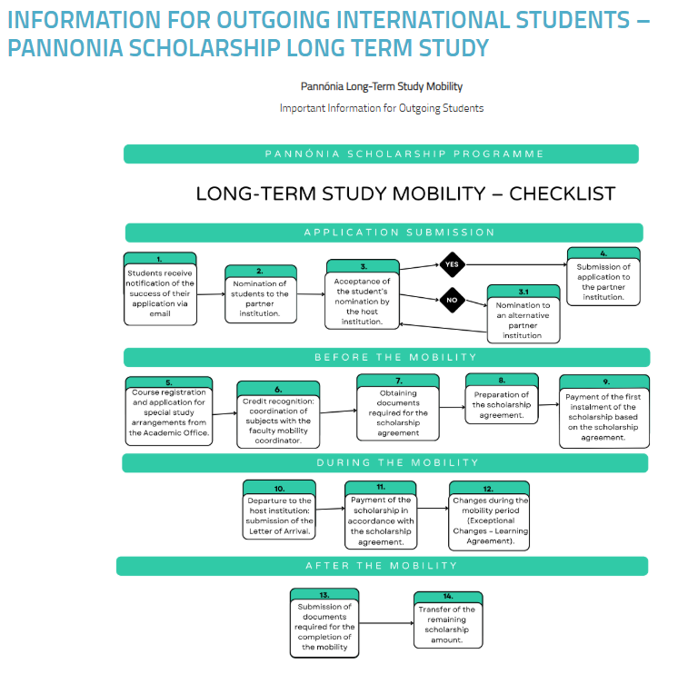
Website
https://ipc.sze.hu/en_GB/home → Information for Outgoing International Students – Pannonia Scholarship Long term study

Slide 6


PANNÓNIA Scholarship ProgramME
Active student status
Long-term mobility: minimum 2 months
Short-term mobility: 2-30 days
A student can receive Pannónia scholarship for a maximum of 12 months per study cycle
Signing the Learning/Mobility Agreement is a must
Scholarship agreement
Study mobility is only possible at partner institutions
Research or traineeship mobility: students independently search for host institutions
Credits earned during mobility must be recognised

Slide 7
Pannónia scholarship Student requirements
Studies, Research | Traineeship
Active semester: Home university enrolment + tuition fee payment (if applicable)
Fulfillment of Scholarship Agreement (credit completion):
Complete the academic requirements: 30 credits per semester (including domestic credits), of which at least 15 credits must be completed abroad | Fulfill the traineeship requirements Fulfill the required domestic exams (if applicable)
Study/work at the partner institution for the specified period (exact dates!)
pannoniaosztondij.hu https://ipc.sze.hu/en_GB/home

Slide 8

Scholarship rate
Pannónia Monthly Scholarship by Country Groups supplementary aid daily rate calculation – 30-day financial month
Tuition fee exemption at the partner institutions
In the case of short-term mobility, additional travel support may be available (for travel days), and for excellence programmes, supplementary support may be provided upon available invoices
Other additional aid options:
Domestic scholarships
EHÖK travel support (with provision of invoice) – ehok.sze.hu

Slide 9
Tasks Before Departure
Studies | Traineeship, Research
After the nomination, submitting the application at the host institution (Deadlines, forms!) | Apply to the host institution (search for traineeship position)
Obtaining the approval from the departmental coordinator and the programme supervisor for departure
Prepare the Learning Agreement (LA): Select courses, coordinate with the academic responsible person/faculty coordinator Complete the Online Learning Agreement (OLA) | Prepare the Mobility Agreement (MA), coordinate with the departmental coordinator /programme supervisor
Enrollment, request for special study plan if necessary (through the Education Office)
Booking accommodation, arranging travel
Insurance (European Health Insurance Card + Liability Insurance + BBP) | European Health Insurance Card + Liability Insurance + BBP
In order to sign the scholarship contract for scholarship: a completed data form is required containing personal and banking details
Downloadable documents: https://ipc.sze.hu/essential-documents

Slide 10
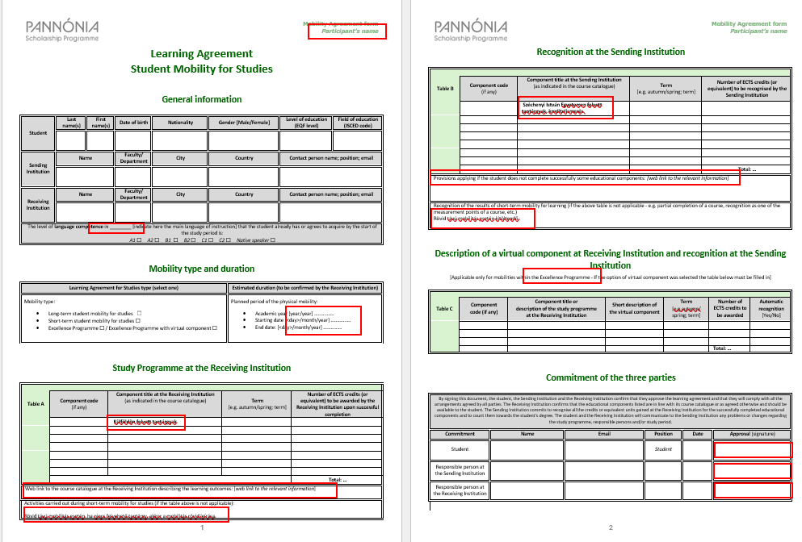
Learning Agreement for Studies

Slide 11



Erasmus Without Paper (EWP) Online Learning Agreement (OLA)
Erasmus app:
Simplifies administrative processes and navigating abroad
Can be managed from a smartphone
https://www.learning-agreement.eu/
Pannónia form is required alongside

Slide 12


Help with Finding Traineeship Abroad
INTERNET! (With a good motivation letter)
Help available on our website: https://ipc.sze.hu/en_GB/help-with-finding-traineeship-abroad
http://erasmusintern.org
https://myinternship.eu/
https://ipc.sze.hu/en_GB/won-application

Slide 13
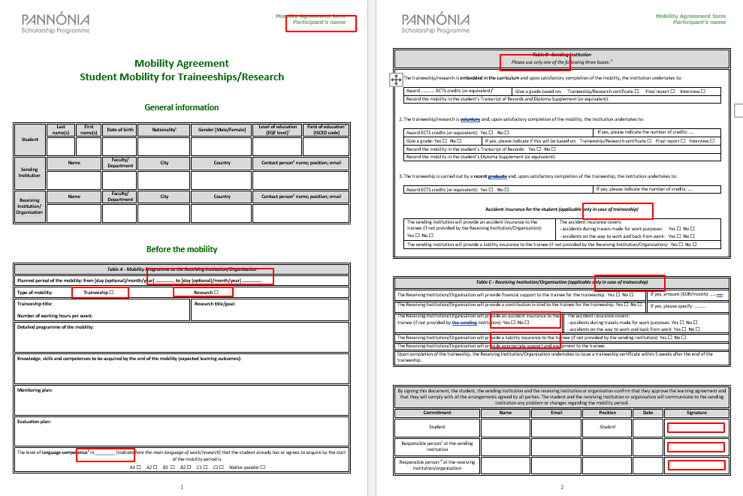
Mobility Agreement BEFORE mobility

Slide 14


Tasks at the Partner Institution
Study (mandatory)
Have fun (optional)
Creating memories (unavoidable)

Slide 15

Tasks During Mobility
If there are any changes compared to the original documents, you must fill out the "Exceptional Changes to the Learning Agreement" section (DURING the mobility)
Course cancellation / Enrollment in a new course
Modification of the mobility duration
Extension is possible within the limits of the Pannónia financial resources. If extending for a full semester:
Submit proof for semester-long courses, Transcript of Records
Submit approval for the extended semester
Submit the Learning Agreement with updated dates
The new document must also be signed by both the sending and receiving departmental coordinators

Slide 16
Tasks after Mobility
Studies | Traineeship
Submit Transcript of Records or Submit completed and signed Learning Agreement after the mobility document | Submit traineeship certificate or Submit completed and signed Training Agreement after the mobility
Submit signed Letter of Participation (if the previous documents do not include the duration of stay)
Submit the credit recognition form
Downloadable documents: https://ipc.sze.hu/essential-documents
If required, submit receipts for reimbursement (Excellence Scholarship, EHÖK)
Prepare an official report (based on email information)
Share your positive experiences (experience report) Inquire whether the partner institution accept students in the future☺

Slide 17
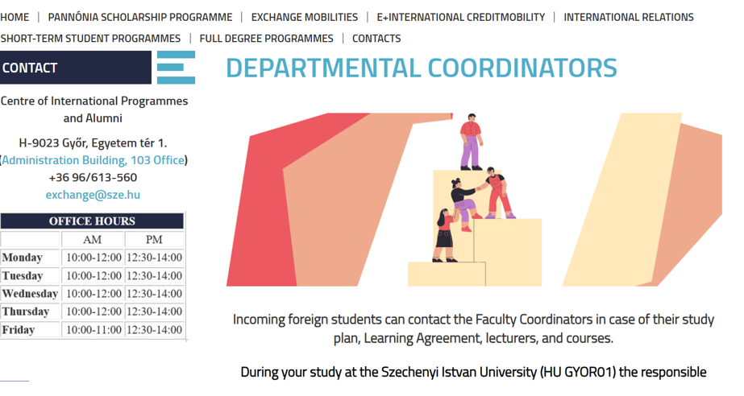
Departmental Coordinators
https://ipc.sze.hu/en_GB/departmental-coordinators#

Slide 18

Contact
International Directorate
Website: https://ipc.sze.hu/en_GB/home
Kocsis Kinga
Medve Zsófia Nagy Ildikó
exchange@sze.hu
Telephone: 96/505-621; 96/505-622; 96/505-624
ÚT. 107. office

Slide 19

We wish you a successful mobility!

